Slide 1

Department of Computer Science and Engineering
An Internship on
“Full Stack Development”
Internship carried out at
JCE Innovation & Entrepreneurship Foundation
Presented By : Vivek Lokolakar (2JI22CS123)
Guide Name
Prof. Nalinakshi B G

Slide 2
ABOUT COMPANY
Company Profile
JCE Innovation & Entrepreneurship Foundation (JIEF) is an initiative operating under the Jain College of Engineering (JCE) ecosystem and the JGI Group. It functions as a nonprofit/section-8 style foundation focused on building an entrepreneurship and innovation ecosystem for students and early-stage startups.
What company do?
Mentorship & Industry Linkages
Training & Capacity Building
Collaborations & Formal Agreements
Consultancy & Advisory Services
Incubation & Start-up Support

Slide 3
TECHNOLOGY LEARNED
Technology | Purpose / Learning Outcome
HTML5 | Used for structuring the web interface and page layouts.
CSS3 | Used to design responsive and user-friendly interfaces.
JavaScript (ES6+) | Implemented dynamic behavior, state updates, and event handling in UI components.
React JS | Learned component-based UI development, props & state management, routing, and API integration.
Vite | Used as a fast development build tool for React projects.
Tailwind CSS | Built consistent, customizable, and modern UI styling with utility-first classes.
DaisyUI | Used pre-designed UI components for faster, clean, and uniform interface creation.

Slide 4
Technology | Purpose / Learning Outcome
Node.js | Used as server-side runtime environment to run JavaScript on backend.
Express.js | Developed REST API endpoints and middleware for authorization and request handling.
JWT (JSON Web Token) | Implemented secure authentication and role-based access control.
Socket.io | Enabled real-time notifications and live updates between server and client.
Technology | Purpose / Learning Outcome
MongoDB | Learned NoSQL database modeling and schema structuring for flexible data handling.
Git | Learned branch management, commits, merging, and maintaining project history.

Slide 5
APPLICATION
Used in organizations to manage employee records and maintain their role, department, and responsibilities.
Helps assign work orders to managers and employees in a systematic manner.
Enables real-time tracking of task progress and work completion status.
Maintains centralized database records, reducing paperwork and manual errors.
Supports resource planning and work monitoring in an ERP environment.
Useful for small to medium enterprises to streamline operational workflows.

Slide 6
Worked On
Designed and developed the full-stack web application using React, Node.js, Express, and MongoDB.
Implemented role-based login system for Admin, Manager, and Employee.
Created modules for Employee Management, Department Management, and Work Order Assignment.
Integrated Socket.io for real-time notifications and status updates.
Structured database schemas using Mongoose for scalable data storage.
Tested and debugged complete workflow to ensure smooth and efficient system performance.

Slide 7
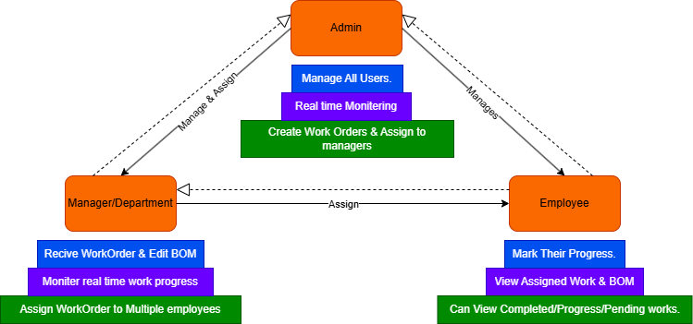
MODULE DEVELOPED AT COMPANY

Slide 8
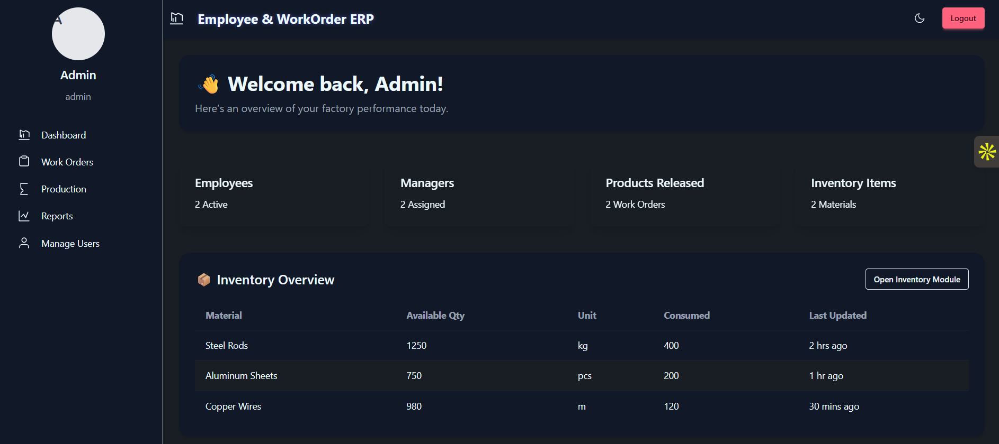
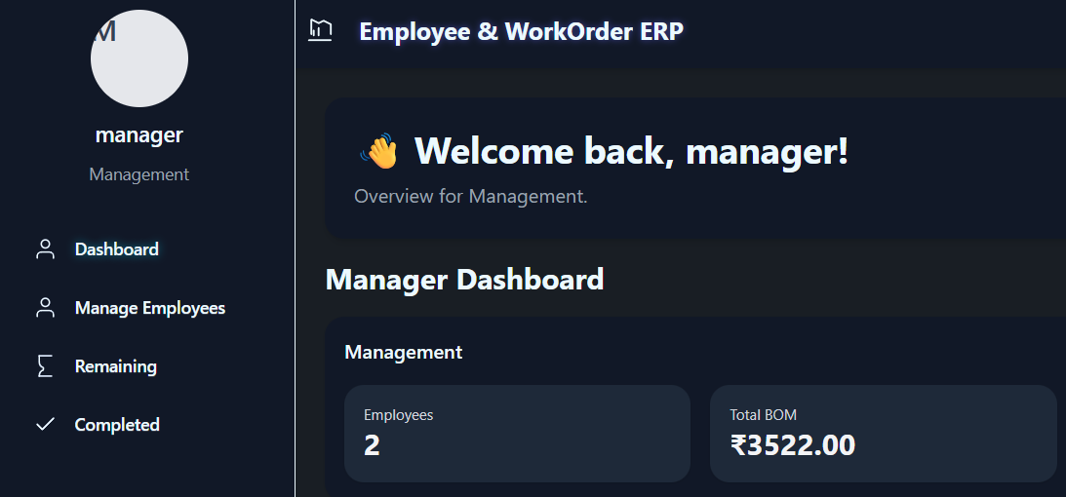
Snapshots/ Results
https://employee-and-workorder.onrender.com/

Slide 9
OUTCOME OF INTERNSHIP
Gained Hands-on Full Stack Development Skills.
Improved Understanding of Real-Time System Workflow.
Developed Role-Based Authentication & Security Concepts.
Strengthened Problem-Solving and Debugging Ability.
Enhanced Technical Collaboration and Documentation Skills.

Slide 10
Thank
You

